Slide 1


Resume Classification

Slide 2

Team Members
Mentor
Geetika
Mounika
Raxita
Aakash
Jafar sadiq
Sreedhar

Slide 3
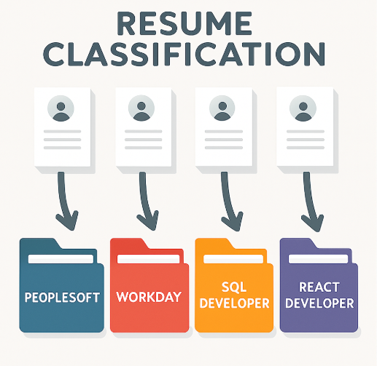
Objective
A resume classification system analyzes resume data and classifies it into predefined job roles using Natural Language Processing (NLP) and Machine Learning techniques. It helps automatically organize and categorize resumes based on skills, experience, and job categories, thereby reducing manual effort in candidate shortlisting and improving recruitment efficiency.

Slide 4
Dataset Details
Attributes | Details
Total Records : | 79 Resumes
Business Domain : | Recruitment / HR Tech
Use Case : | Automated Resume Filtering
Target Variable : | Job Category (e.g, SQL developer)
Feature Type : | Text , Categorical , Numeric

Slide 5
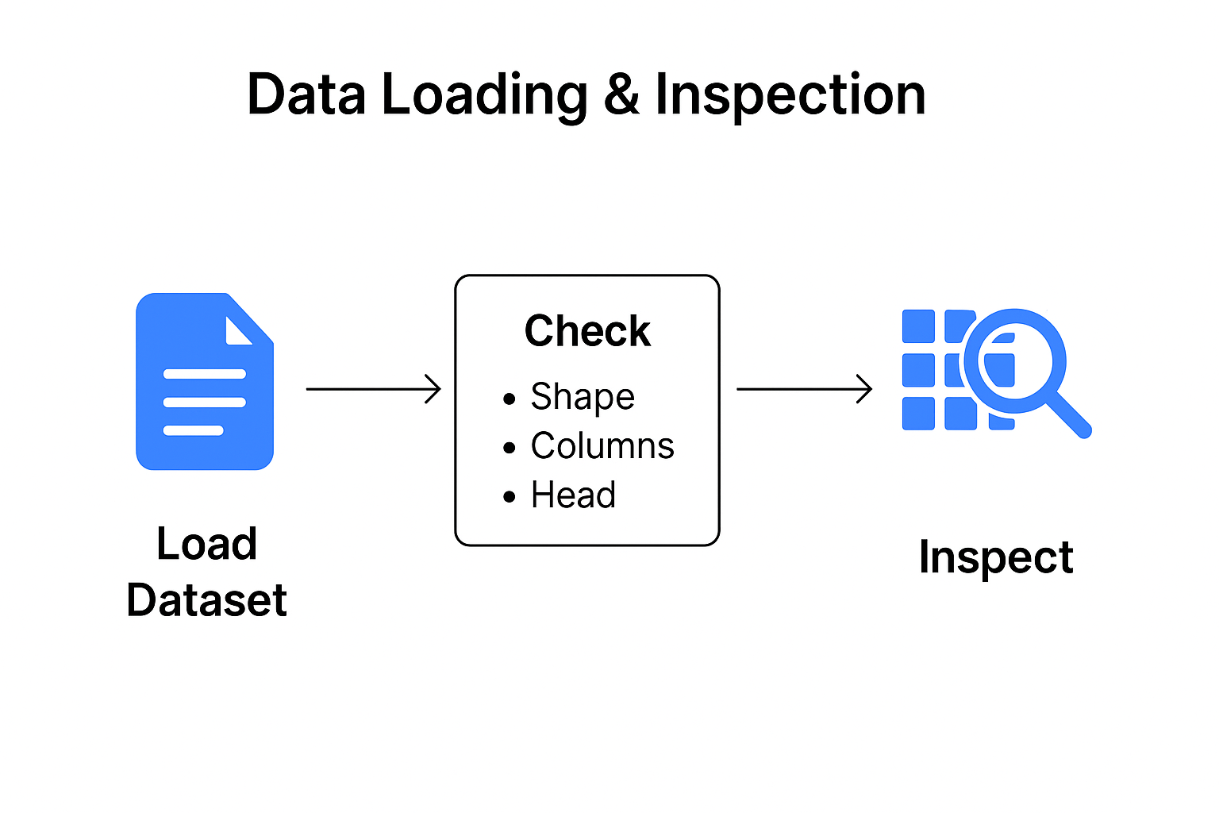
Data Collection
Data Loading
Resumes dataset collected from folder containing multiple resume files (PDF/DOCX/DOC)
Check shape (rows, columns), column names, first few records.

Slide 6
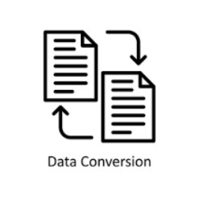
Data Conversion
Converted all PDF and DOC files to DOCX format
Ensure compatibility with Python libraries for automated text extraction.
Used Python libraries: pdf2docx and python-docx

Slide 7

Data Cleaning
Removed unwanted characters, numbers, and symbols
Converted text to lowercase for uniformity
Removed stopwords (common words with little meaning)
Applied lemmatization (standardized words to root form)
Generated clean text for feature extraction and classification

Slide 8

Exploratory Data Analysis (EDA)
Statistical Analysis
The statistical analysis provides insights into resume distribution across categories, highlights dominant skills, experience levels, and text characteristics. This helps in understanding dataset balance and guides feature engineering for better classification.

Slide 9
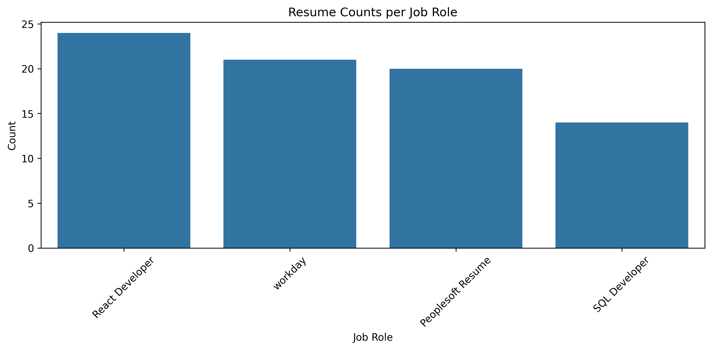
Exploratory Data Analysis (EDA)
Bar Chart
The dataset is slightly imbalanced, with React Developer having the most resumes and SQL Developer having the fewest. This imbalance can influence model training and may require handling techniques like class weighting or oversampling.

Slide 10
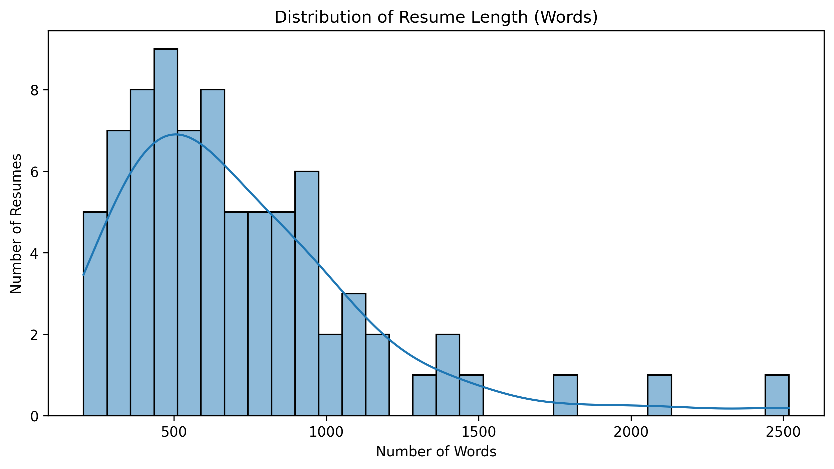
Exploratory Data Analysis (EDA)
Histogram
The majority of resumes are concise (300–800 words), while a few outliers exceed 2000 words. Outlier resumes may need normalization (e.g., trimming or padding) to avoid bias during model training

Slide 11
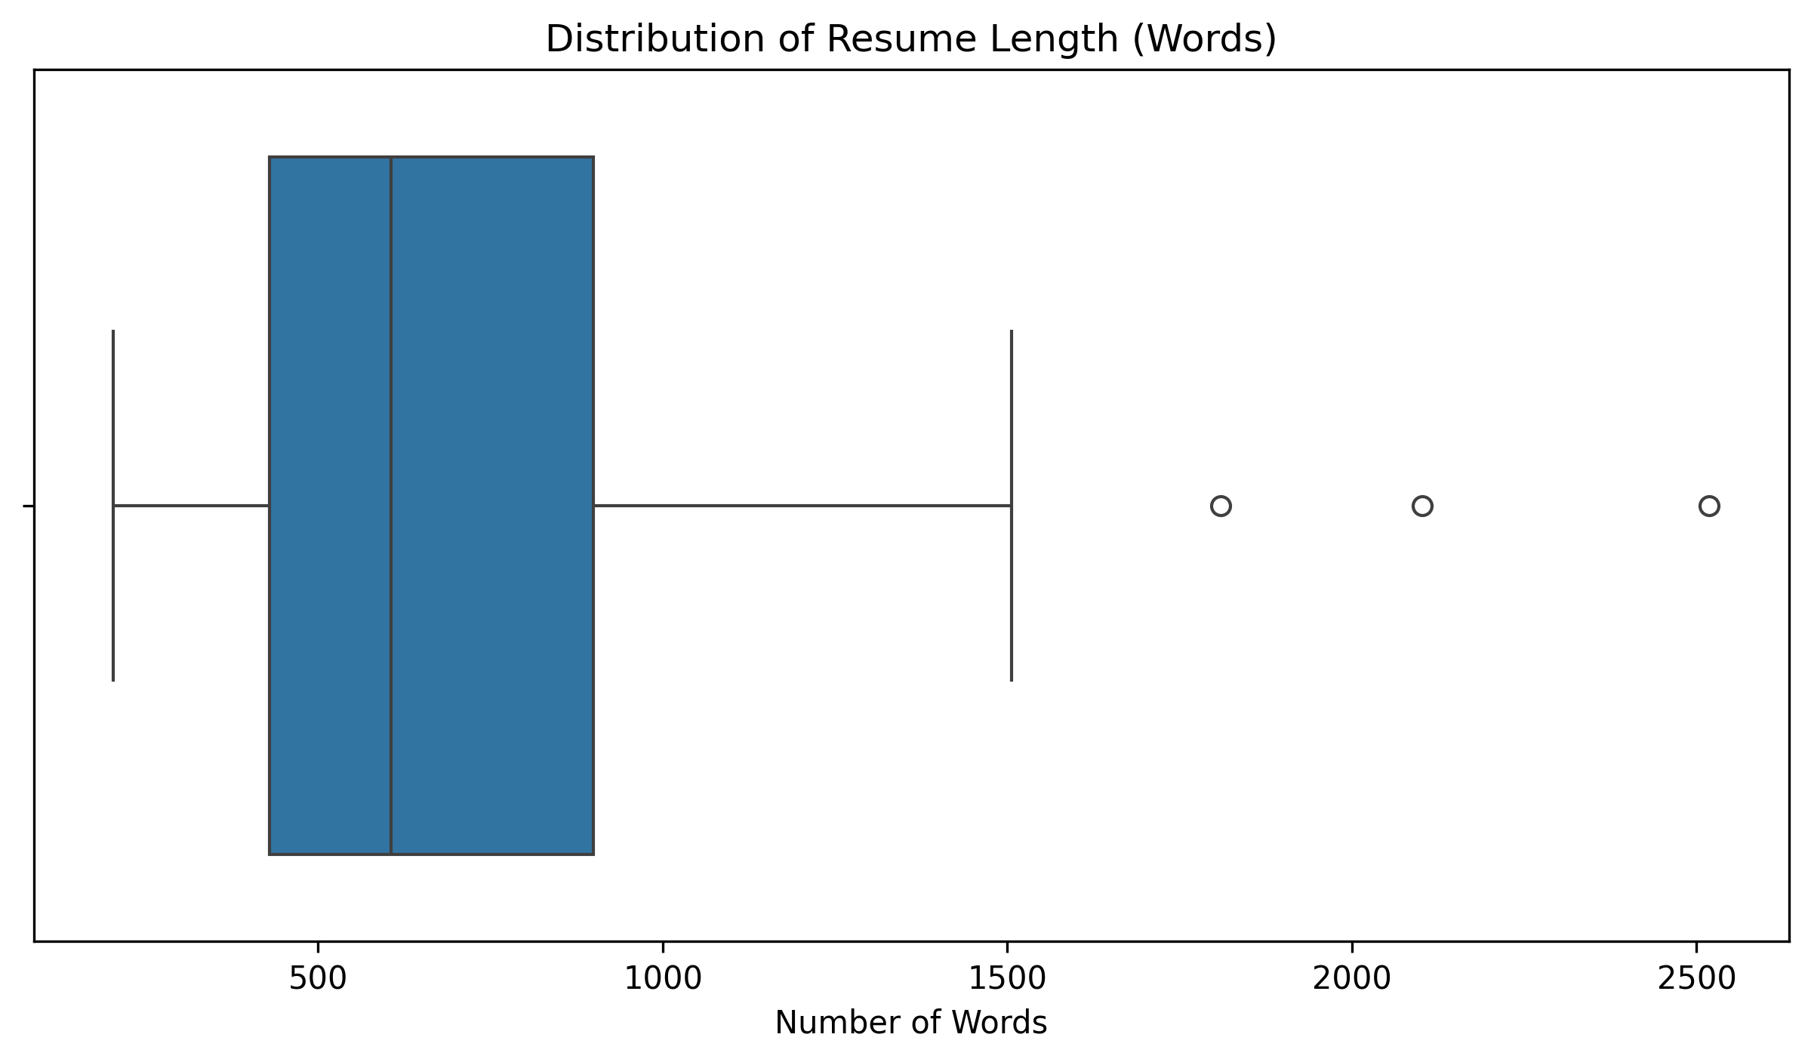
Exploratory Data Analysis (EDA)
Box Plot
Most resumes are between ~400 to ~1500 words.
The median resume length looks around 600-700 words.
Some resumes are extremely long (2000–2500 words) → possibly CVs or uncleaned data (like job descriptions included)
.
Outliers may need checking during data cleaning, because they could affect your classification model

Slide 12
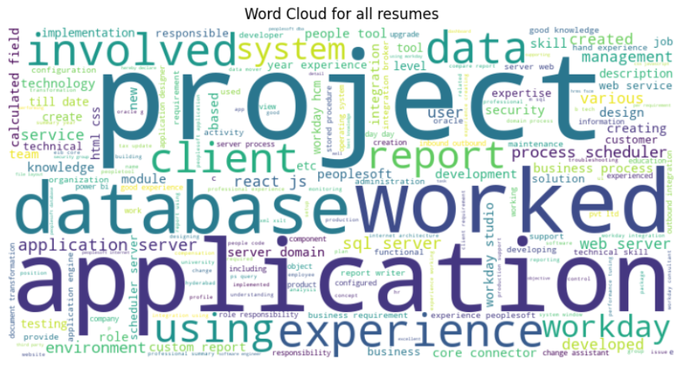
Exploratory Data Analysis (EDA)
Word Cloud
Visualizes most frequent words in resumes
Larger words = higher frequency of occurrence
Highlights key skills (e.g., database)
Helps in understanding dominant skills across resumes

Slide 13

Feature Engineering
Feature engineering is the process of transforming raw resume text into meaningful inputs that improve the performance of classification models
Used TF-IDF vectorization to convert resumes into numerical representations

Slide 14
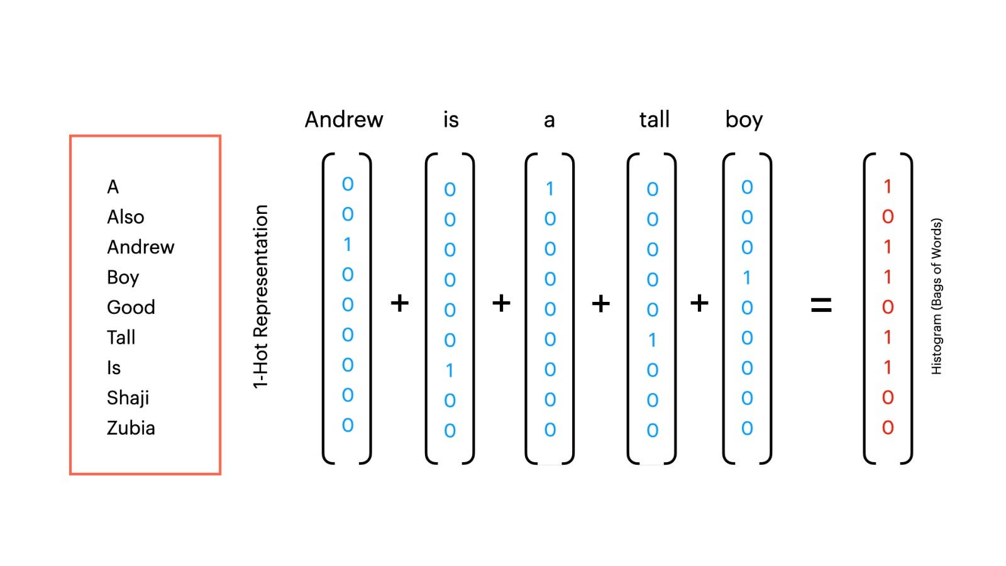
TF-IDF
Converts text into numerical features for ML models.
Term Frequency (TF): Measures how often a word appears in a document.
Inverse Document Frequency (IDF): Reduces the weight of common words across all documents.
Outcome: Each resume is represented as a vector that models can understand.

Slide 15

Model Building
Models Used:
Logistic Regression: Fast, interpretable, supports regularization.
Multinomial Naive Bayes: Works well with text data
.
Complement Naive Bayes: Performs better on imbalanced classes.

Slide 16
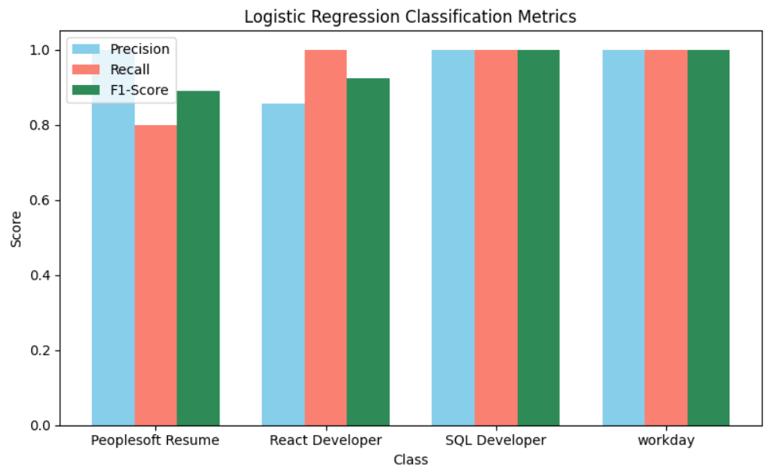
Logistic Regression
The Logistic Regression model shown is a multinomial classifier used for predicting multiple classes.
Logistic Regression achieved 93% testing accuracy
Accuracy scores indicate how well the model learned the training data

Slide 17
Model Evaluation for Logistic Regression
Classification Report
Class | Precision | Recall | F1-Score | Support
Peoplesoft Resume | 1.00 | 0.80 | 0.89 | 5
React Developer | 0.86 | 1.00 | 0.92 | 6
SQL Developer | 1.00 | 1.00 | 1.00 | 2
Workday | 1.00 | 1.00 | 1.00 | 3
Accuracy Table
Accuracy | Value
Training Accuracy | 1.00 %
Testing Accuracy | 0.9375 %

Slide 18
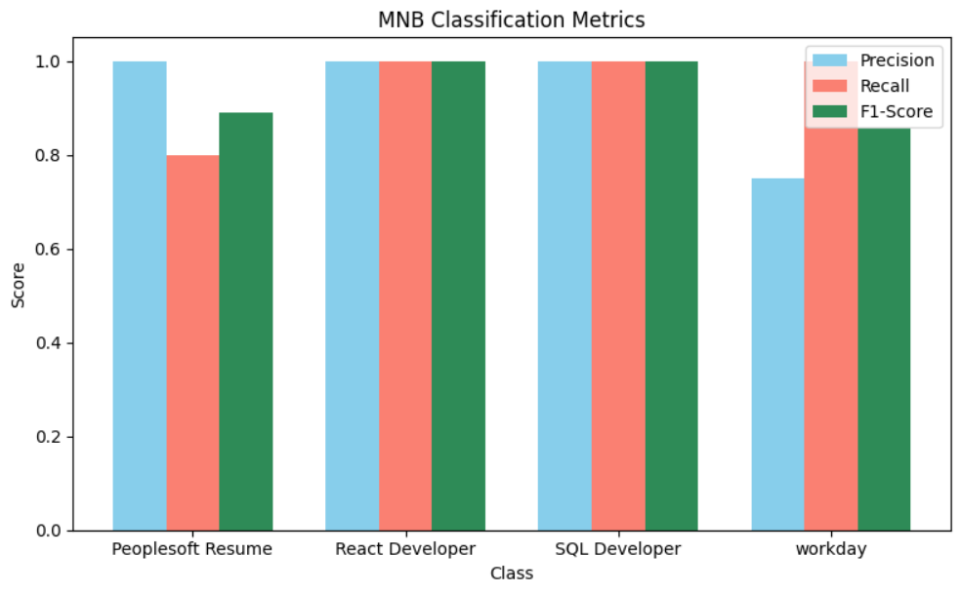
Multinomial Naive Bayes
The Multinomial Naive Bayes (MNB) model is a probabilistic classifier commonly used for text classification and other discrete feature data.
The model is trained using features and labels to learn class probabilities.
The model is after training, it predicts the class labels for the test data
Training accuracy and testing accuracy scores indicate how well the model fits the training data and generalizes to unseen data.
Multinomial NB achieved 93% testing accuracy

Slide 19
Model Evaluation for MNB
Classification Report
Class | Precision | Recall | F1-Score | Support
Peoplesoft Resume | 1.00 | 0.80 | 0.89 | 5
React Developer | 1.00 | 1.00 | 1.00 | 6
SQL Developer | 1.00 | 1.00 | 1.00 | 2
Workday | 0.75 | 1.00 | 0.86 | 3
Accuracy Table
Accuracy | Value
Training Accuracy | 1.00
Testing Accuracy | 0.9375

Slide 20
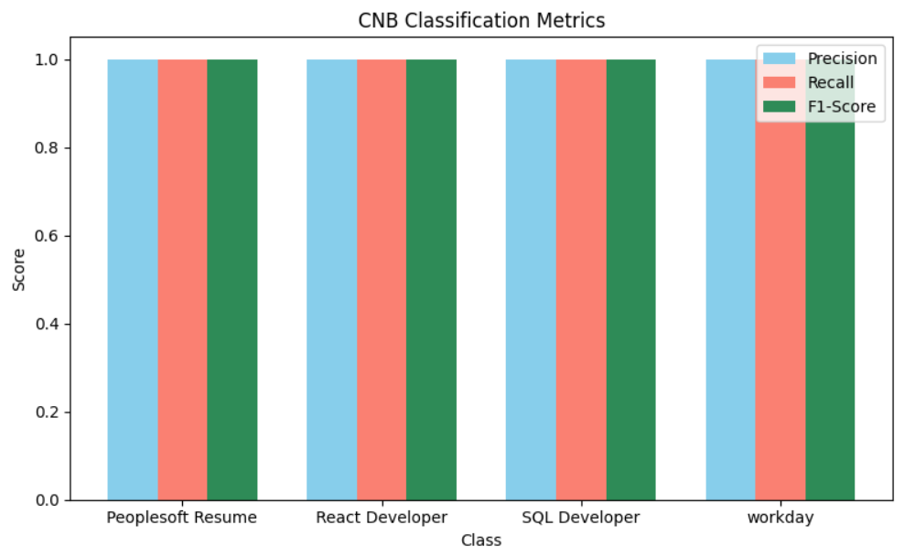
Complement Naive Bayes
The Complement Naive Bayes (CNB) model is an improvement over the traditional Multinomial Naive Bayes, specifically designed to handle imbalanced datasets more effectively.
It adjusts the feature count complements, reducing bias towards frequent classes, which helps improve classification performance on skewed data.
CNB performs better logistic regression and multinomial NB with 100% testing accuracy

Slide 21
Model Evaluation for CNB
Classification Report
Class | Precision | Recall | F1-Score | Support
Peoplesoft Resume | 1.00 | 1.00 | 1.00 | 5
React Developer | 1.00 | 1.00 | 1.00 | 6
SQL Developer | 1.00 | 1.00 | 1.00 | 2
Workday | 1.00 | 1.00 | 1.00 | 3
Accuracy Table
Metric | Value
Training Accuracy | 1.00
Testing Accuracy | 1.00

Slide 22

Selecting Final Model
Final Model Used: Complement Naïve Bayes
Why: CNB is often the best choice for small, sparse, imbalanced text datasets

Slide 23
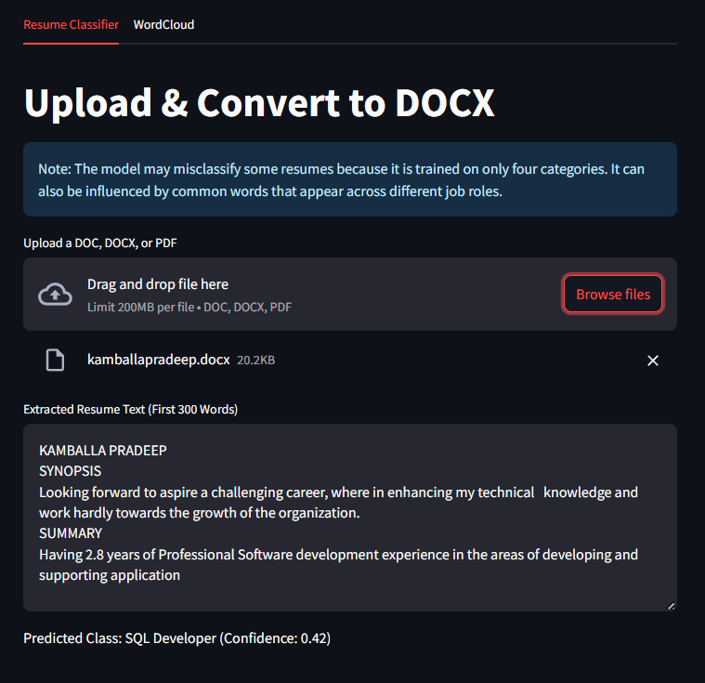
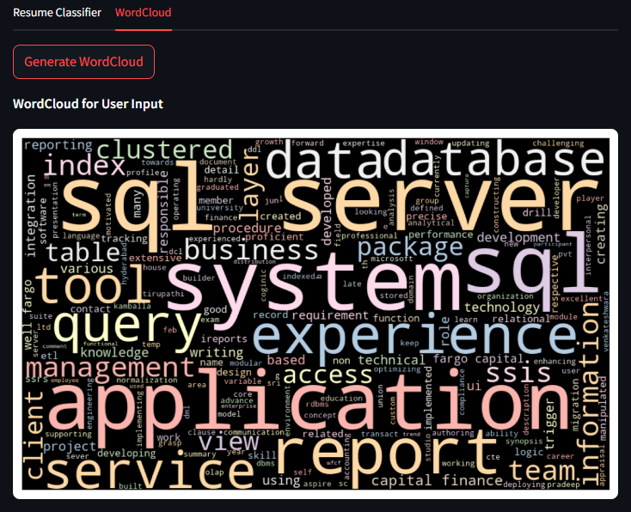

Streamlit Deployment

Slide 24

Challenges Faced
Unstructured data (pdf, doc, docx)
Risk of Overfitting
Small and Limited Datasets
Not much variety in resumes
.

Slide 25
Thank you
Team Members
Aakash
Jafar sadiq
Mounika
Raxita
Sreedhar

